Slide 1


Slide 2

SATURDAY 8TH DECEMBER
PARISH HALL (NAGLE COLLEGE)
VIGIL MASS at 6PM
CHRISTMAS CAROLS at 8PM
Food & Drink will be on sale from 7pm

Slide 3
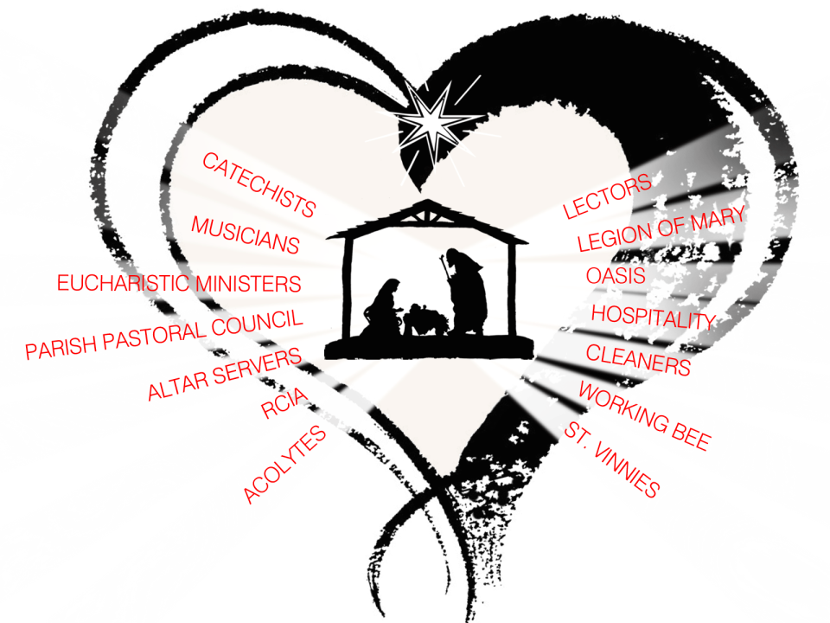

Slide 4

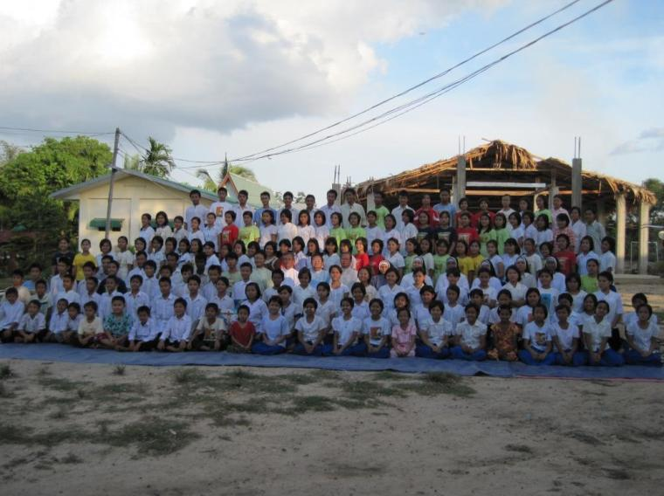
ORPHANAGE IN MYEIK MYANMAR (BURMA

Slide 5
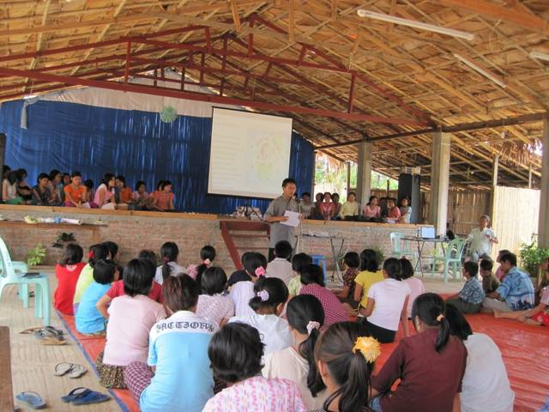

ORPHANAGE IN MYEIK MYANMAR (BURMA

Slide 6

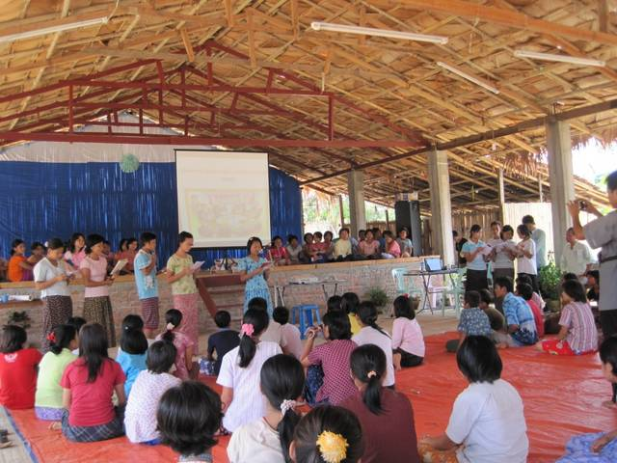
ORPHANAGE IN MYEIK MYANMAR (BURMA

Slide 7


Slide 8


